Slide 1
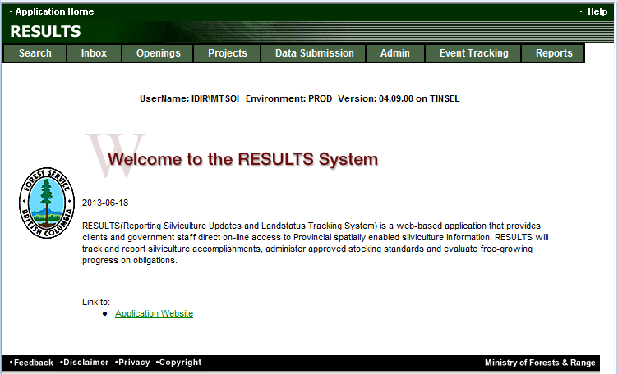
RESULTS Training
Core Module 2
Obligation Reporting
Online Entry and Mandatory ESF Conditions
Sept 2013

Slide 2
Learning Objectives
Business Guidelines
Guidance on Mandatory ESF
Online or ESF Matrix
Technical documentation references
Differences between mandatory vs. edit checks
Mandatory conditions for New Opening (ESF or Online)
Mandatory Spatial and Site Plan Indicator usage
Help resources

Slide 3
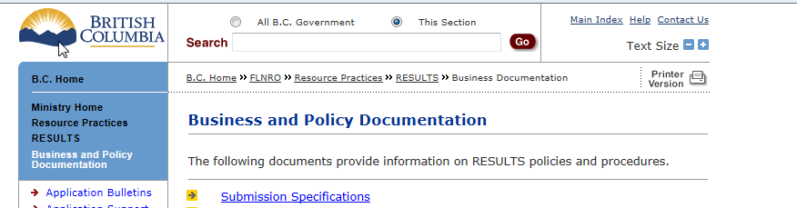
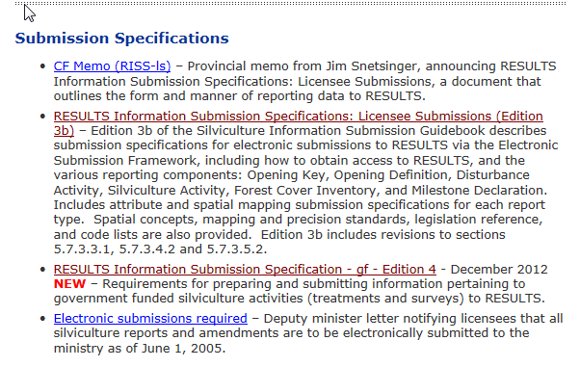
Business Guidance
http://www.for.gov.bc.ca/his/results/business.htm

Slide 4
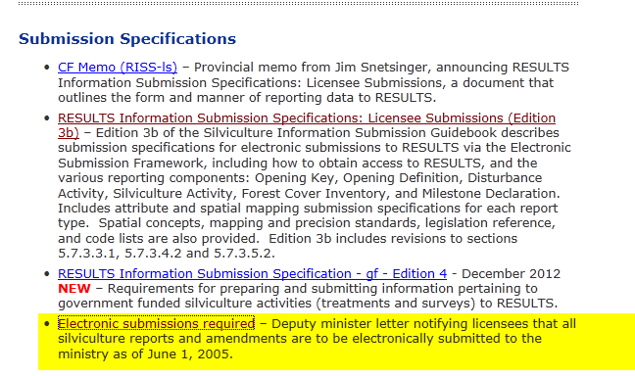
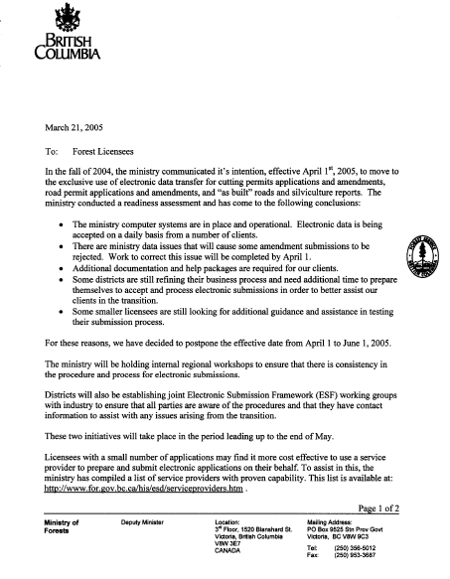
Mandatory ESF

Slide 5
Online or ESF Matrix
Submission Component | ESF | Online
Opening Definition Tenure & Site Plan Information | Yes | No Opening and Standards Unit Spatial required
SU Modifications* | Yes | Conditional ESF where there is changes to Standards Unit (additions, deletions) or changes in spatial.
Disturbance | Yes | Yes
Silviculture Activity | Yes | Yes Mandatory ESF for government funded activities (FE, JS)
Forest Cover * | Yes | No Forest Cover Spatial required
Milestone | Yes | Yes
s.108 Application | No | Yes
* Any spatial requirements must be submitted by ESF

Slide 6
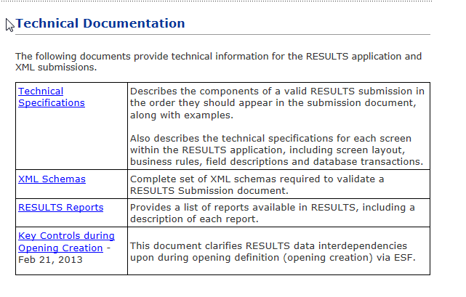
Technical Documentation References http://www.for.gov.bc.ca/his/results/techDocs.htm

Slide 7
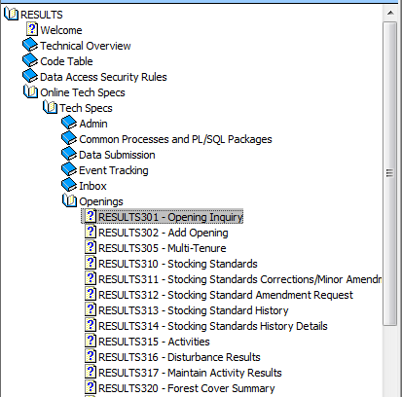
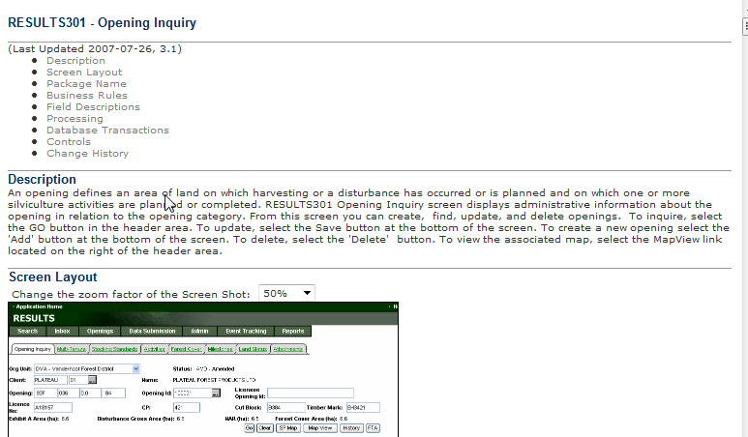
Technical Documentation Online References
http://www.for.gov.bc.ca/his/results/techDocs.htm
Tech Specs has Online Reference with business rules and field specific edits.
Reference by Screen Number.

Slide 8
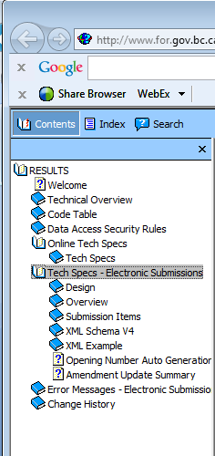
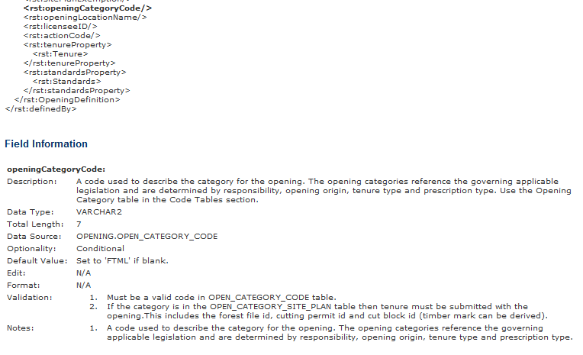
Technical Documentation ESF Schema References
http://www.for.gov.bc.ca/his/results/techDocs.htm
Tech Specs has ESF Reference with business rules and field specific edits.
Reference is by schema item.

Slide 9
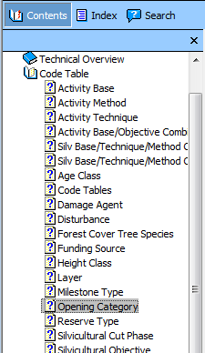
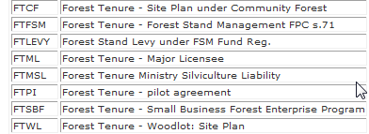
Technical Documentation Codelists
http://www.for.gov.bc.ca/his/results/techDocs.htm

Slide 10
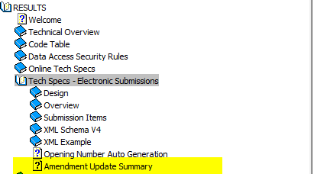
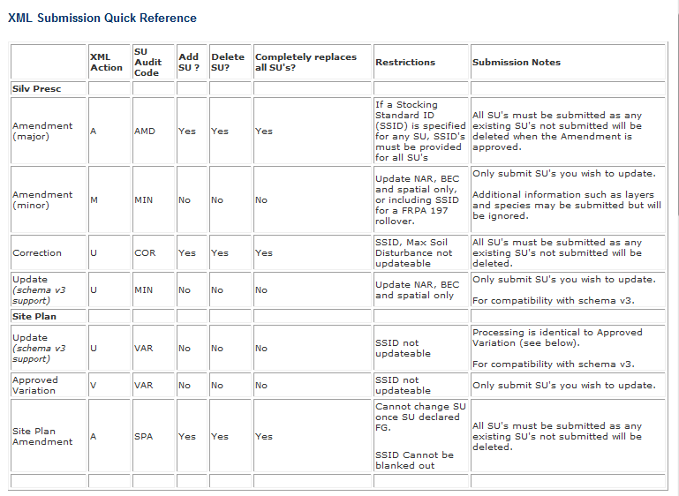
Technical Documentation SU Modifications Cheatsheet
http://www.for.gov.bc.ca/his/results/techDocs.htm

Slide 11
Mandatory legal requirement vs. Edit Checks
RESULTS Information Submission Specification document provides information on mandatory data requirements.
RESULTS will provide some rudimentary system’s checks for codes, basic data quality and data dependencies but cannot check for all legal requirements due to complexity and requirement for interpretation.
It is responsibility of the submitter to ensure that the data submitted is consistent with legal requirements.
Any system’s edit checks are described in the RESULTS Technical Specifications webpage.

Slide 12
Mandatory Tenure for New Openings (Online or ESF)
http://www.for.gov.bc.ca/his/results/Key%20Controls%20during%20Opening%20Creation-Feb%2021%202013.pdf
New Opening Online or Action “I” - Insert
Opening Category:
  FTML, FTWL, FTSBF, FTLEVY, FTFSM, FTMSL, FTNOLVY, FTWL, FFTITSL, FFTLTC
Tenure(s) must exist in Forest Tenure Administration (FTA) and in Cutblock Status Active Cutblock Status of “HB”
Tenure(s) must be assigned to the same client and org unit as the submitter
System’s validation done through OPEN_CATEGORY_SITE_PLAN_CODE

Slide 13
Mandatory Tenure for New Openings (Online or ESF)
http://www.for.gov.bc.ca/his/results/Key%20Controls%20during%20Opening%20Creation-Feb%2021%202013.pdf
For submission with tenure – have two options:
  Tenure Key: Licence Number + Cutting Permit ID + Cutblock ID
  Timbermark Key: Timbermark + Cutblock ID
RESULTS allows one or more cutblock to be associated with an opening – a multi-tenure opening.
One cutblock for an opening must be designated as the Prime Licence <rst:prime LicenceIndicator> set to “Y”.
All cutblocks associated with an opening must belong to the same client and for same org unit

Slide 14
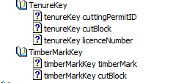

Mandatory Tenure for New Openings (Online or ESF)
Tenure information appears twice in the opening definition
Key (either as Tenure key or Timbermark Key)
Typically what is designated at the prime licence
2. Tenure section
  Can have one or more cutblock assigned to one opening
  One cutblock must be designated as prime licence
  All other cutblocks must be designated as non-prime licence
  Prime licence will be the record that will be associated with the opening and appear in the “tombstone” but all referenced cutblocks will appear under “Multi-Tenure” Tab.
  All cutblocks must belong to same client as the submitter and same org unit.

Slide 15
Mandatory Spatial ESF Requirement
http://www.for.gov.bc.ca/his/results/Key%20Controls%20during%20Opening%20Creation-Feb%2021%202013.pdf
Validation check via ESF for Opening, SU or Forest Cover Spatial
Opening Category where Opening and Forest Cover Spatial mandatory
  FTML, FTWL, FTSBF, FTLEVY, FTFSM, FTMSL, FTNOLVY, FFTITSL, FFTLTC
Unless
  Unless Opening Approval Date < 2003-12-31 (RESULTS Production release date)
  Forest Cover exists but record was before 2005-05-01 (data conversion date)
  Minor amendment ( “M”) or Correction (“U”)
System’s validation done through OPENING_SPATIAL_REQUIREMENT

Slide 16
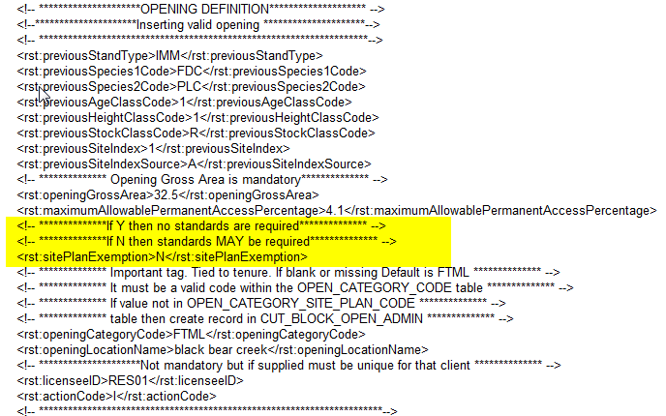
SU Requirement & Role of Site Plan Exempt Ind
http://www.for.gov.bc.ca/his/results/Key%20Controls%20during%20Opening%20Creation-Feb%2021%202013.pdf
All New Openings via ESF must have at least ONE Standards Unit in the Opening Definition
Rst: sitePlanExempt is an indicator used by RESULTS to determine if Standards Unit is:
  a silviculture prescription “Y” – full stocking standards provided ; OR
  a site plan “N” – an approved standards regime ID authorized by submitter is provided or where applicable, Ministry FDP default stocking standard.

Slide 17
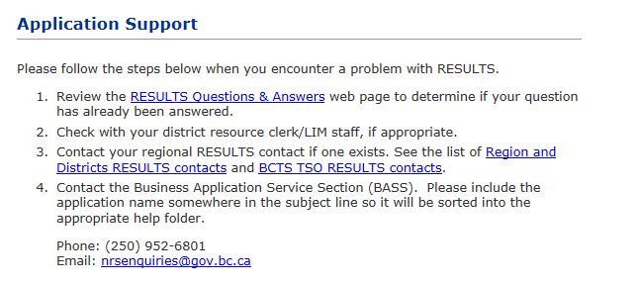
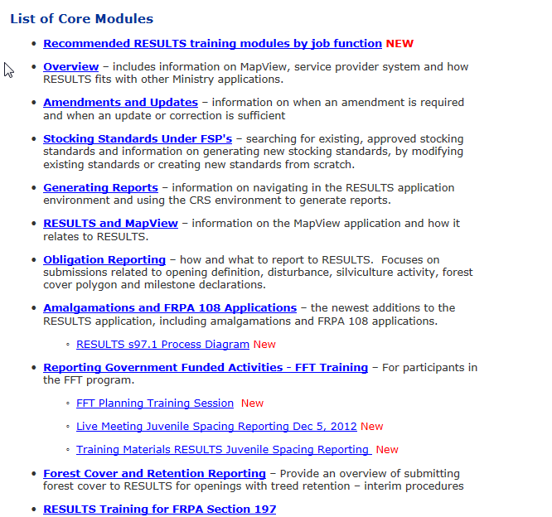
Help Resources
http://www.for.gov.bc.ca/his/results/support.htm
http://www.for.gov.bc.ca/his/results/training/index.htm
E-Stand Enhancement

